Slide 1
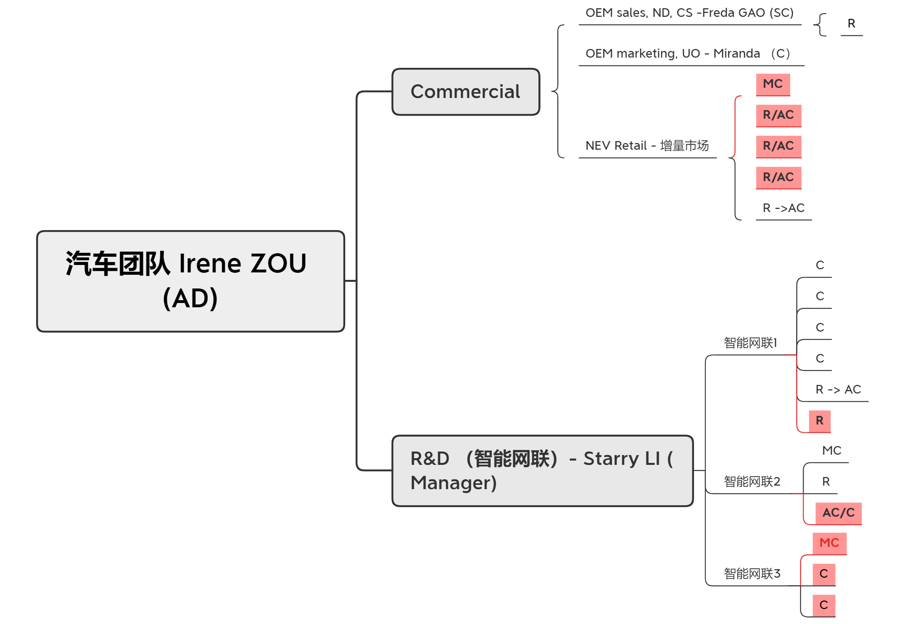
2021 Org-Chart

Slide 2
2021 Org-Chart
Manager-Starry
MC-Daisy
C-Jack
C-Milena
C-Wayne
New MC
New AC
New R
New R
R-Mickoo

Slide 3

Team Org Chart – 2021
Q1
Ken
Christine
Sunny
Iris
Renly
Jasmine
Amber
MC
C
C
Q2
Ken
Christine
Sunny
Iris
Renly
Amber
Jasmine
MC/SC
C
C
R
AC

Slide 4
Team Org Chart – 2021
Roman
AC/C-商务/售后
C/SC-RD
New MC-RD
New R
New AC/C-RD
New AC-RD
New R
R
Notes:
Q1: 1 R for sales/RD, 1AC for RD; 1AC for RD;
Q2: 1C for RD; 2R for RD/sales, support team, and self;
Q3:
Q4:
R to add new data, polish data;

Slide 5
2021 Org-Chart
Helen Zhang
Shane Lu
Manager
Jackey Sun
Manager
Ivan Gao
Education Leader
Manager
MC
MC

Slide 6
2021 Org-Chart
Ivan
MC-Ivy
Stella
SC-Linda
C-Jimmy
SC-Irving
AC-Jessica
New AC
New intern
New C

Slide 7
2021 Org-Chart
Jackey Sun
New Manager-retail
Researcher
Kelly MC
Researcher
Lisa C
Elaine C
New MC or Consultant-Luxury
New AC
Christy AC
Rachel AC

Slide 8
2021 Org-Chart
Shane
Manager
Intern Researcher
Manager
Researcher
Consultant
PC
AC
Researcher
Intern Researcher
New AC
New Consultant
New Consultant
New Consultant
New Consultant

Slide 9
2021 Org-Chart
Jessie Si
Wendy Chen-MC
Irene HU-AC
Kyle Tan-C
New R
Ben Zhou -C
Zoey Cai-AC
New R
Paul Pan-AC

Slide 10
2021 Org-Chart
Michelle Mi
Consultant
AC
AC
Consultant
Consultant

Slide 11
2021 Org-Chart
Suki Wu
New Manager
New Researcher
New MC
New Researcher
Consultant
Kristy Pan
Researcher
Freda Zhou
Associate Consultant
Suzy Chen
New AC

Slide 12
2021 Org-Chart
Cathy Wang
AC
Researcher
New Consultant
New
Consultant

Slide 13
2021 Org-Chart
Vincent
Sales marketing
Tina（New Retail）
Bonnie（Mkt/PR/GA）
Consultant/AC（Digital/CRM）
Technical
Seven（IT）
MC/Manager
Consultant（RD）
Researcher
C/AC（OEM Sales）
Researcher
Supporting
HR/Legal
Consulting/Services
Researcher
Christine
Ada（Auto Service）
Consultant/ACAC（IT）
C/AC（Central Sales）
北京

Slide 14
Borskar
Clark
Monica
Eric
Caroline
Alyssa
SC
C/AC
Alice
Lucifer
Krystal
MC/Mgr
AC
R
R
R/Intern
Melody
青岛

Slide 15
2021 Org-Chart
Sr. Partner
Vicky ZHANG
互联网
New TL
Daisy
AC→ C
金融
New SC/MC
New Researcher
New AC
Grace
AC→C
Monica
AC
Betty
Researcher
智能制造
New TL
Zaki
R→AC
New AC
2021 HC Planning
Level | 2021 Beginning | New hire | Promotion | Departure | 2021 1Q
Sr. Partner | 1 |  |  |  | 1
MC/Manager |  | 1 |  |  | 1
SC |  | 1 |  |  | 1
C |  | 1 | +2 |  | 3
AC | 3 | 2 | -2+1 |  | 4
RA | 2 | 1 | -1 |  | 2
Total | 6 | 6 | 3 |  | 12
2021 New Hire: 6 HC
智能制造 * 1 (Sr. C)
互联网 * 3 (1Leader + 2AC)
金融 * 2 (C+R)
Total : 12 HC by 1Q 2021

Slide 16
2021 Org-Chart
Manager
Janet Wang
FPD&IC Equipment
Commercial &High Level Position
Consultant
Lisa Lei
PV &Dispensing Equipment
Commercial&BU Head
New Researcher
Consultant
Rachel Xu
FPD& IC Equipment
ME&EE function
AC
Laura Zhou
PV &IC-wet process Equipment
ME&EE Fuction
New Senior Consultant
SW/Visual/Algorithm Function-Eastern China
New Researcher
New Consultant
SW/Visual/Algorithm Function-Southern China
New Consultant
RGV&AMR
Industry
New Researcher

Slide 17
2021 Org-Chart
Sharon Li
Researcher
MC
Researcher
SC
AC
New R
New AC
New C

Slide 18
2021 Org-Chart 2021年组织架构
Julia NIE
Managing Consultant 陈国勇
Consultant1 耿溪
Managing Consultant
Researcher/AC
Consultant 张思平
AC 赵永吉
Researcher/AC 王健
Consultant2 张悦
AC 张瑞
Researcher 谷泽峰

Slide 19
2021 Org-Chart
Chris
Chris Sales BU 1
Julia
Mary Consulting BU
Jessica
Ocean Online BU
Yvonne Solution
Zoe Supporting
Coco
Sally SZ Office
Wenjun Guo BJ Office
Shelley
Jasmine
Lee
Sales 1
Sales 2
Karen
Kate
Young
Tilly
Sales 3
Sales 4
项目总监
项目经理
Nicole
Assistant 1
Sales 5
Sales 6
Yuki SC Office

Slide 20

Team Org-Chart
Manager
销售
BD交付
销售培训
内容运营
用户运营
市场渠道

